Slide 1


Mesos
Dudi Likvornik
J.P. Morgan
2017

Slide 2
Building a distributed system
I came to the idea of building a new distributed app, even before knowing what I want the app to do.
Anatomy of the system (Not handling peer to peer):
Coordinator
Workers

Slide 3
Building a distributed system
Main features you come to think about when designing a coordinator Distributed system:
Execution model of Tasks (Not multi threading or processing).
Tasks will run simultaneously.
Deal with failures in tasks and workers (fault tolerance).
Handle resources elastically.

Slide 4
Building a distributed system – Managing resources
Distributed systems are built for scale.
Want to scale your system? Add more cheap hardware (Memory, Hard drive and logical processors).
Scale to

Slide 5
Building a distributed system
How to distribute the resources?
Easy – having a single Distribution Frame work, give it all the resources, the coordinator will handle it all.
All resources can be distributed statically.

Slide 6


Static Partitioning
But what happens when we have more than one DFWs on the same set of resources?
Lets begin with static partitioning.

Slide 7
Static Partitioning - Problem 1
One of the FW does not fully utilize the CPUs.
Storm is idle, but spark cannot use the resources.

Slide 8
Static Partitioning - Problem 2
Ok, lets give all the resources to both.
They will oversubscribe the resources, no fairness and prioritization (If Spark is more important, how can we enforce that?).

Slide 9
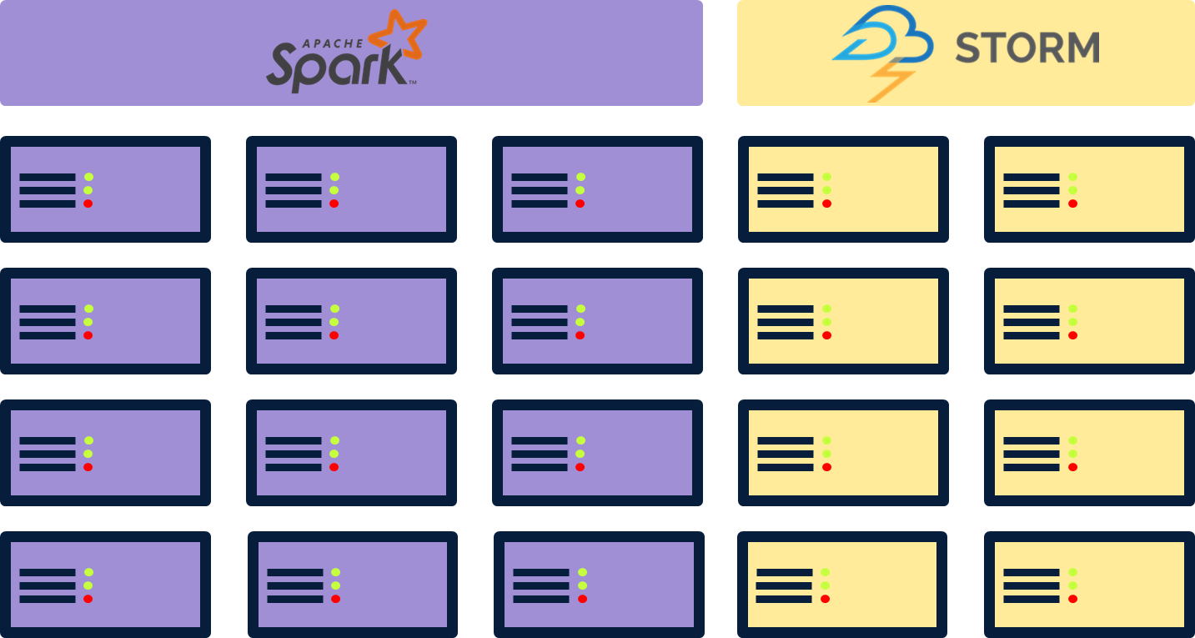
More problems
Hard to deal with failures – Each FW will have to deal with it, on its own.
Duplication of effort of dealing with
distributed infrastructures.
Operators (Data centers) need to maintain multiple clusters.

Slide 10

Apache Mesos
Operating System === Datacenter
Node 1
Node 2
Node 5
Node 3
Node 4

Slide 11
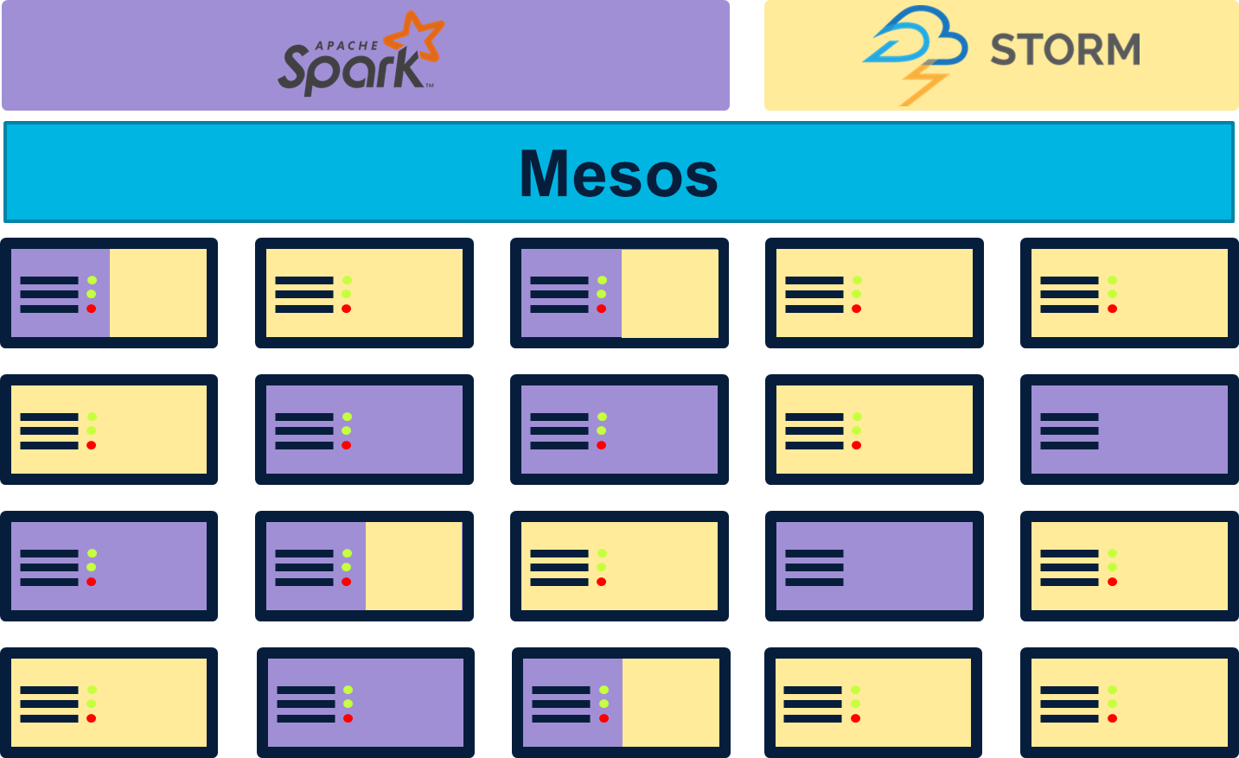
Apache Mesos

Slide 12
Apache Mesos
Feature Type | Feature
Scale | Supports up to 10,000 nodes
Resource allocation | Many type of resources – Cpus, RAM, Hard drive space, etc…
Resource allocation | Fair in allocation policy (Lottery allocation for example).
Resource allocation | Managed elastically.
Resource allocation | Allows priority between users, and reservations.
Resource allocation | Uses containers to enforce resource allocated per task.
Fault tolerance | Keep replicas of Master and Slaves and uses Zookeeper for election.
Fault tolerance | Checkpoints.
Fault tolerance | Uses containers to enforce isolation between tasks.
Policies | Allows Operators and Frame works to set policies.
Multi language | Support REST API with no need for client support.
Client support | Client support in C++/Java/Scala/Python.
UI | Provides WEB UI and allows queries in HTTP.

Slide 13
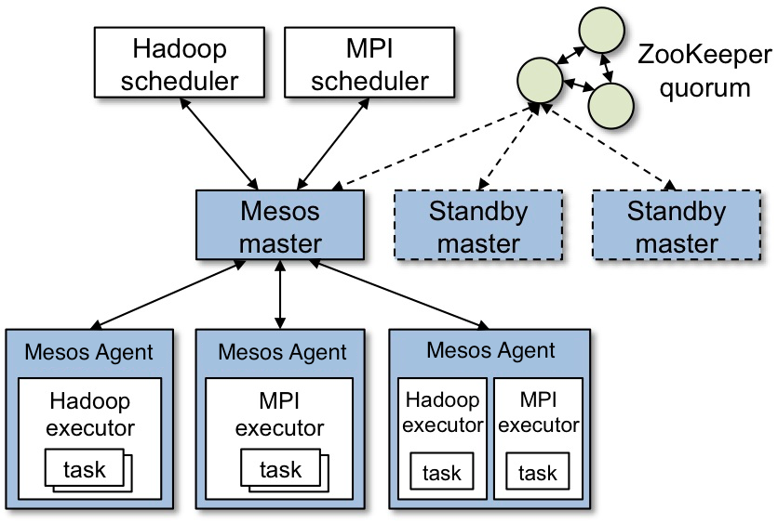
Mesos Architecture

Slide 14
Mesos Architecture
Mesos components:
Mesos master –
Manages agent daemons, each daemon runs on a cluster node.
Manages frameworks which will submit tasks to run on those nodes.
Mesos agent – run on cluster nodes, each agent will manage the node’s Resources, Tasks and Executors
Will initiate tasks on demand.
Will initiate executors (done lazy) on demand and pass tasks to them.
Will report all communication back to the master.
Framework components:
Framework scheduler – schedule tasks on Mesos cluster
Framework executor – runs tasks

Slide 15
Mesos Flow
Master, All agents and user FW are spawned.
1
2) The FW scheduler registers with mesos Master.
3
3) Mesos master starts offering resources to the FW scheduler.
2
4
1
4) FW Scheduler schedules some tasks, master diverts the tasks to the designated agent and an executor is spawned and provided with tasks.
1
4
4

Slide 16
Distributed Frame Work Components
Lets change terminology:
Scheduler – the key feature of the coordinator –
upon receiving resources will decide which task will run and how many resources to use.
Will manage its own policies.
Task – a finite action bound to resources (Tasks can be short, can be long, but they always run to an end).
Executor – Provide another layer of management on top of tasks, can create tasks on request.
Executors can run indefinitely.
Coordinator
Scheduler
Workers
Tasks/Executors

Slide 17
Apache Mesos – Framework communication scheme
Scheduler speaks with mesos master.
Two types of messages –
Calls – Scheduler messages to Mesos master.
Events – Responses to calls from Master to Scheduler (Most of the times).
One way message passing, all messages are unreliable (Not request response system).
Calls examples –
Creating task with given resources to run on Node #.
Stop task #.
Event examples –
Task status.
Resources offers (An event which was not triggered due to a call).
All messages are well typed, possible responses are also known.
Example – Upon sending a “Launch Task” message from the scheduler,
Mesos master can response in:
Task status.
Request is rescinded.
Scheduler
Calls
Events
Mesos Master

Slide 18
Apache Mesos – Framework communication scheme
Call Type | Call
Scheduler life cycle | Register
Scheduler life cycle | Un Register
Scheduler life cycle | Re Register
Resource allocation | Request resources
Resource allocation | Decline a group of resources
Resource allocation | Revive a group of resources
Task Management | Launch Task
Task Management | Kill Task
Task Management | Reconcile the Status of the task

Slide 19
Apache Mesos – Framework communication scheme
Event Type | Event | Response to which Call
Scheduler life cycle | Registered | Register
Scheduler life cycle | Reregistered | Register
Resource allocation | Offer resources | None
Resource allocation | Rescind resources | Launch Task
Task Management | Task status | Launch Task/Kill Task

Slide 20
Apache Mesos – Framework communication scheme
Scheduler
Register
Master
Mesos now will allocate resources to the FW
Registered
Offer
Master allocates some resources
Scheduler can decide to use resources to run tasks
Launch
Master launches a task on a specific slave
Offer
More resources are allocated
Update
Status update on launched task
time

Slide 21
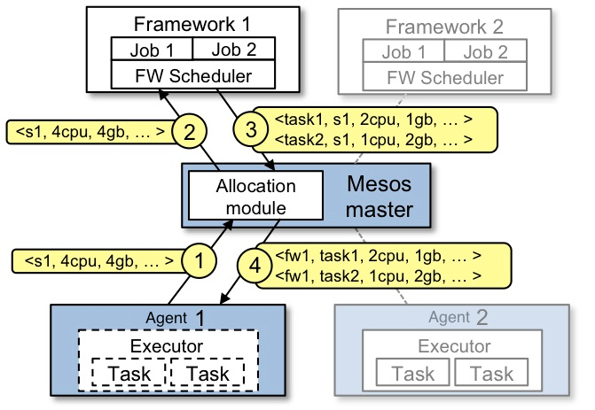
Resource Offer
Two level scheduling
Resource allocation process does
not need to know how scheduling happens
Makes Mesos stable and scalable
Mesos and frameworks can
evolve independently
Framework scheduler can reject an offer
Allows applying advanced scheduling (data locality)
Multiple & extendible resource offers
policies
Fairness, priority, reservations, …
Collaborative resource management
(although preemption by killing is possible)

Slide 22
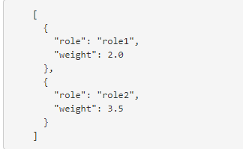
Advance features – Roles (Resources guarantee, priority)
Mesos acts as an operating system of a data center.
Roles are equivalent to users in Linuex/Windows in the cluster.
Role – a resource consumer with in the cluster.
A user.
A group.
A Frame Work.
Schedulers may subscribe to a role in order to receive designated resources (bound to a role).
Role provides the following capabilities:
Assigning resources specific to a role (resources gurantee):
Some where in the cluster (Qouta).
At a specific agent (Reservation).
Setting weights (Priority) between different roles.

Slide 23
Advance features – Checkpoints
Upon Agent crash or close (due to update):
Agent will be brought up.
Two policies towards Tasks and Executors:
Will kill all existing Tasks and Executors.
Will reconnect with executors and let known tasks continue their run.
if checkpoint is active by Frame Work.
Checkpoint allows the Agent to write its current state to the HW (At cost of IO operations) in checkpoints (along time).
State includes:
Current known Executors ids.
Current known Tasks ids.
Improve fault tolerance at the cost of IO.

Slide 24
Framework Development

Slide 25
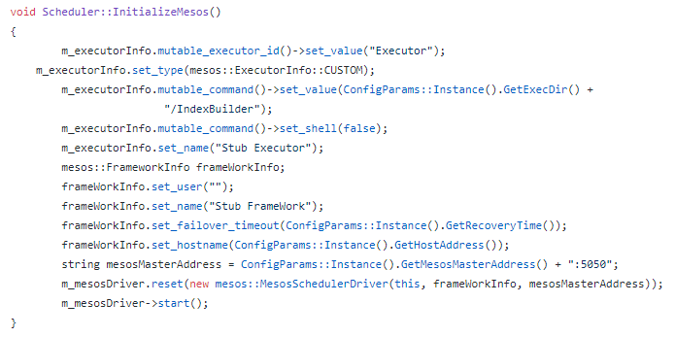
Scheduler API
Can be written in C++/Java/Scala/Python
Framework implements the org.apach.mesos.Scheduler interface
Create executor info, optional.
Create frame work info.
Create mesos client (driver), providing it –
The scheduler, the frame work info, the address of the master
Connecting in sync manner
To the master, without waiting after wards.

Slide 26
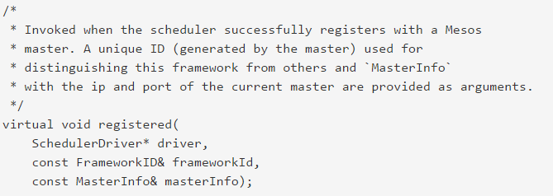
Scheduler API
Indicates framework succeeded to register on Mesos

Slide 27
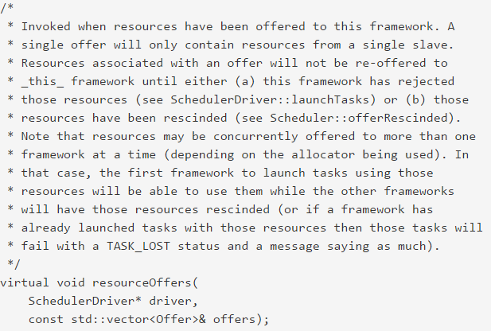
Scheduler API
Offered by Mesos
Each Offer from a single agent
Can be offered to multiple frameworks simultaneously
Framework should use part of offer or reject it

Slide 28
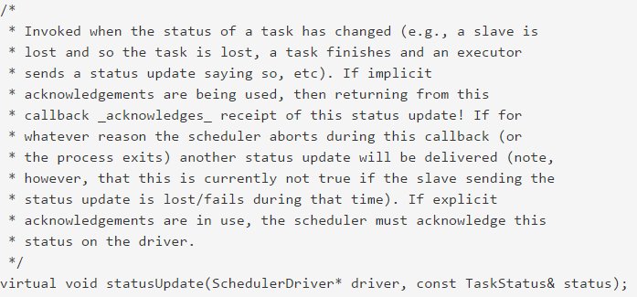
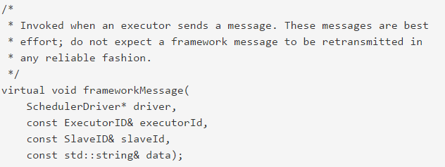
Scheduler API
Indicates a task status has changed
Framework executor-to-scheduler message

Slide 29
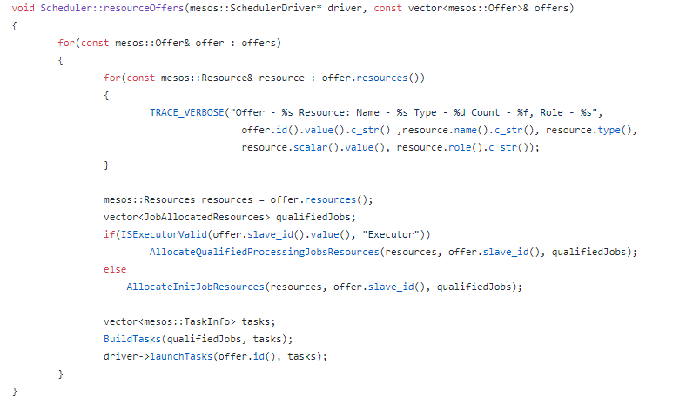
Scheduler API
Launching tasks:
Iterating across offers (one per agent)
Getting the current offer resources.
Allocating resources per task
Building tasks and sending tasks to mesos master.

Slide 30
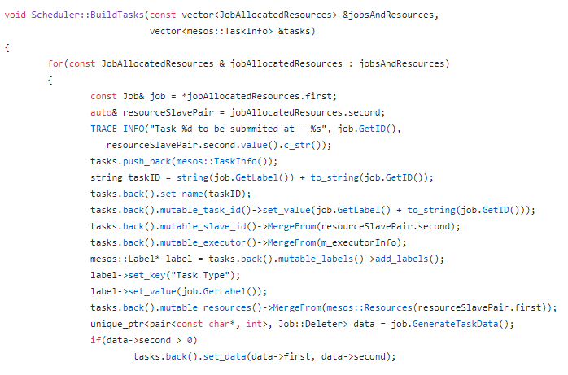
Scheduler API
Launching tasks:
Creating a task info.
Setting which resources
the task will use
The task will be submitted to an executor, providing the executor info
Providing binary safe data

Slide 31
Executor API
Mesos provides a simple executor:
Execute shell commands and Docker containers.
Framework can create a custom Executor
A task is not a process.
Resources granularity can now be threads.
Can cache data in Executor (Spark)
Etc.

Slide 32
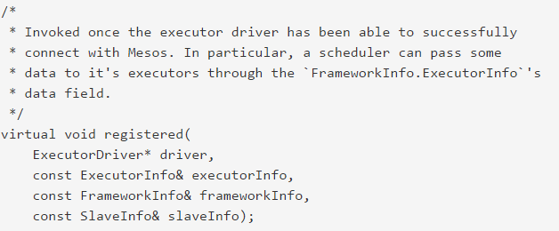
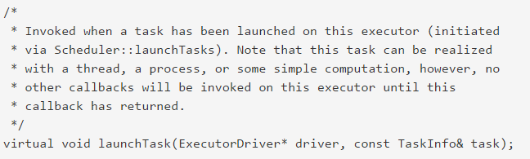
Executor API
Indicates executor succeeded to register with Mesos
Invoked upon task scheduling

Slide 33
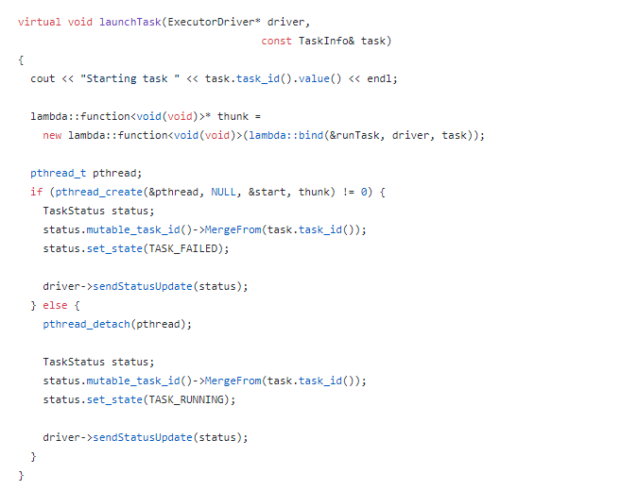
Executor API
Does something
Sending task status back.

Slide 34
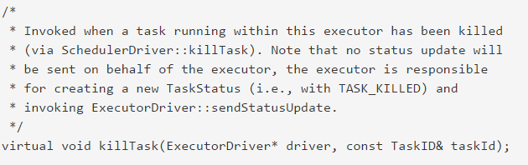
Executor API
Asking the executor to kill a task (by framework scheduler)

Slide 35
The App

Slide 36
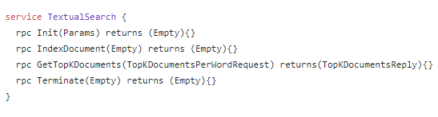

Distributed App
Going to build a distributed app using mesos.
We need an application instance acting as a scheduler:
We need a method of communication with the cluster:
Lets use GRPC as a solution for IPC.
And depict an interface:
Mmm…. Textual search engine, sounds good ☺.
Cluster Manager
Scheduler
Client
Cluster Manager
Scheduler

Slide 37


Distributed App
Cluster manager will accumulate jobs, before manifesting them into tasks with allocated resources.
The cluster manager scheduler component will interact with mesos master.
Receiving resources.
Scheduling Tasks in return.
Cluster Manager
Scheduler
Jobs
Resource offer
Tasks Launch
Master

Slide 38

Distributed App
Mesos master will address the correct Agent, providing it with the task and executor to run it.
The Executor is encountered for the first time, so it will be spawned.
The task will be diverted to the executor.
Master
Launch Task
Agent
Agent
Agent
Index Builder
Launch Task

Slide 39




Distributed App
The Index Builder will do the following:
Init task - spawn a redis instance in the same node.
Indexing task –
Fetch a document from a given location.
Break it into words and number of words appearances.
Stores words in the context of a document into redis.
Agent
Get Document
Index Builder
Set words

Slide 40
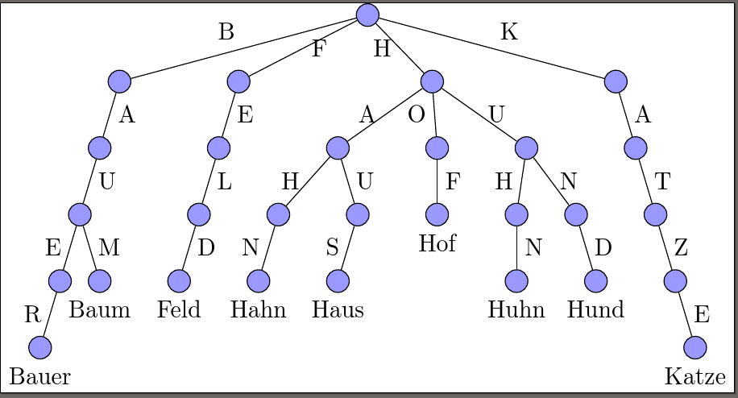
Distributed App
Redis module will save the words into trie tree.

Slide 41
Distributed App
Client
Cluster Manager
Scheduler
Jobs
Resource offer
Tasks Launch
Launch Task
Master
Set words
Agent
Get Document
Index Builder
Launch Task

